Slide 1
Black box techniques Exercises
Prepared by: Radoslaw Poswiata
04 November 2016
Version: 1.0

Slide 2
TASK 1 – Discount System
You are testing e-shop module which is calculating discount and admit free transport for his clients according to following rules
Client Type |  | Invoice Cost
 |  | <50 | 50-150 | 150-300 | >=300
Guest | discount | 0% | 1% | 5%
 | Free Transport | NO |  |  | YES
Registered | discount | 5% |  | 7% | 13%
 | Free Transport | NO |  | YES | YES
Super Client | discount | 10% |  | 15% | 20%
 | Free Transport | YES
Create Boundary-Equivalence tables each type of Client
Create Input file for PICT containing Client Type, Discount and transport variable
Use PICT to generate test cases using All Singles and All Pairs strategy

Slide 3

PICT Tool - Details
PICT Tool - http://download.microsoft.com/download/f/5/5/f55484df-8494-48fa-8dbd-8c6f76cc014b/pict33.msi
PICT Tool information - https://msdn.microsoft.com/en-us/library/cc150619.aspx
PICT tool requires us to write parameters and its possible values in the text file
By default All Pairs algorithm is used
User can specify other coverage conditions like All Singles, it could be done for all and also just some parameters
It is possible to specify which cases should be covered in tests generated by PICT and in that way provide base set of tests
#
# This is a sample model for testing All Pairs
#
P1: A1,B1,C1
P2: A2,B2,C2
P3: A3,B3,C3
#
# This is a sample model for testing All Triples
#
P1: A1,B1,C1
P2: A2,B2,C2
P3: A3,B3,C3
{ AP1, AP2 } @ 1
#
# This is a sample file with base values
#
P1 P2 P3
A1 A2 A3
A1 A2 B3

Slide 4
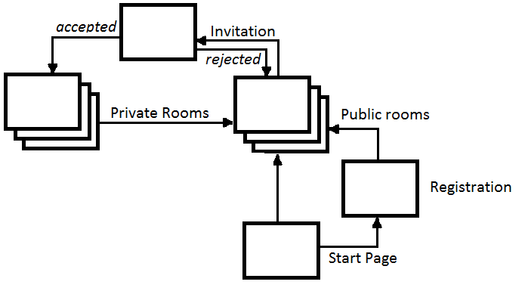
TASK 2 – Conversation System
Consider system (described bellow and diagram showed on the right site) which allows to type with other people.
System can be used by guests or registered users
To become a registered user, user have to define unique user name (login) and password
Each user can open several Public rooms
Each user can invite other user to private conversation
Each Invitation can be accepted or rejected
Please create Use cases for described system.

Slide 5
Thank you!

